Slide 1
Prediction of anti-cancerous activity of Chalcones in colon cancer using machine learning approach
Gaurav Kumar Singh, BM22MTECH11002
Department of Biomedical Engineering
Indian Institute of Technology Hyderabad, Telangana, India

Slide 2
Table of Content
Introduction
Aims & Objectives
Database description
Results
Conclusion
Future modifications
References

Slide 3
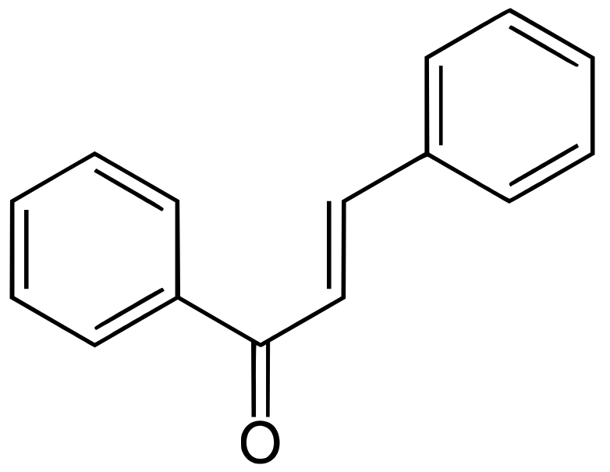
Introduction
Cancer that forms in the tissues of the colon (the longest part of the large intestine).
Colon cancer is the third most common cancer worldwide.
Chalcones are a class of natural products that have a basic structure of 1,3-diphenyl-2-propen-1-one.
Found - naturally occurring compounds such as vegetables, fruits, herbs, etc.
Possesses interesting spectrum of biological activities, including antioxidative, antibacterial, anti-inflammatory, anticancer, etc.
Fig.- Chemical structure of chalcones.
(Source -Wikipedia.com)

Slide 4
Chalcone possess several properties that make them attractive candidates for cancer therapy, it has ability to
Inhibit cancer cell proliferation
Induce cell cycle arrest, promote apoptosis (programmed cell death).
Chalcones had been shown to sensitize cancer cells to chemotherapy and radiation therapy, making them potential adjuvants in combination cancer therapy.
Problem statement -
The process of screening and identifying potential drug candidate and developing new drugs through experiment is very slow and requires a lot of time, manpower and material resources.

Slide 5
Aim and Objective
Aim to predict the IC50 values (Inhibition Concentration at 50%) of chalcones to identify potential anti-cancer compounds for Colon Cancer treatments.
Researchers can use this value to prioritize and select the most promising candidates for further experimental evaluation.
Can ultimately lead to the development of new and effective Colon Cancer treatments.

Slide 6
Workflow:
Data collection
Pre-processing
of data
Descriptor calculator
Model Building
Model Selection
Model Deployment

Slide 7
Database Description
Chalcone DB is used for Data extraction which is based on PubChem compounds.
Chalcone DB is a database of chalcone which consists of only chalcone scaffold and contains around 2,52,653 numbers of chalcone compounds.
The data collected for colon cancer is approximately 3350 molecules having the target HCT116 cell line.
IC₅₀ value of all the assays is extracted with the help of python request library.
IC₅₀ is converted to pIC₅₀ to simplify data analysis and easy model training.
2211 compounds left after pre-processing of data (SMILES extraction & duplicates removal).
All the compounds are validated with Lipinski rule of five (which is a rule of thumb to evaluate druglikeness) using Lipinski descriptors with the help of RDkit using SMILES.
PubChem descriptor are calculated which has 881 fingerprints in number
2211 dataset is split into 80:20 ratio for train(1769) and test(442) dataset.

Slide 8
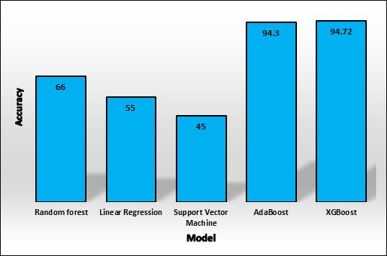
Results
Model Evaluation
Cancer | RF | LR | SVM | XGBoost | AdaBoost
Colon cancer | 66 | 55 | 45 | 94.72 | 94.3

Slide 9
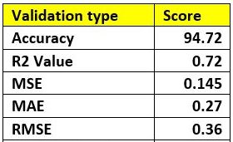
Validation of XGBoost model -
Lower MSE (Mean squared error) values indicate better model performance.
Lower MAE (Mean absolute error) values indicate better model performance.
Lower RMSE (Root-mean-square deviation) values indicate better model performance.
Higher R² value indicates better performance of model.

Slide 10
Conclusion
Drug potency: The predicted IC50 values can provide insights into the potency of the tested compounds or drugs against colon cancer cell lines.
Sensitivity or resistance: The predicted IC50 values can also reveal the sensitivity or resistance of different cancer cell lines to the tested compounds or drugs.
Comparative analysis: The predicted IC50 values can be used for comparative analysis between Colon Cancer cell lines & compounds or drug candidates.
Further experimentation: The predicted IC50 values can serve as a basis for designing further experiments, such as in vitro or in vivo validation studies, to confirm the predicted potency and efficacy of the compounds or drugs.

Slide 11
Future modification
We can deploy the model as web server.
We can calculates different types of fingerprints such as MACCS fingerprint, Klekota-Roth fingerprint, CDK fingerprint, CDK extended fingerprint instead of PubChem fingerprints and check the accuracy of the models.
We can make models for different types of cancer such as Breast cancer, Skin cancer, etc.

Slide 12
References
Ávila HP, Smânia ED, Delle Monache F, Júnior AS. Structure–activity relationship of antibacterial chalcones. Bioorganic & medicinal chemistry. 2008 Nov 15;16(22):9790-4.
Berrouet C, Dorilas N, Rejniak KA, Tuncer N. Comparison of drug inhibitory effects (IC 50) in monolayer and spheroid cultures. Bulletin of mathematical biology. 2020 Jun;82(6):68.
Chennamadhavuni A, Lyengar V, Shimanovsky A. Continuing Education Activity.
Cooper GM, Hausman RE. The development and causes of cancer. The cell: A molecular approach. 2000;2:719-28.
Ekins S, Mestres J, Testa B. In silico pharmacology for drug discovery: methods for virtual ligand screening and profiling. British journal of pharmacology. 2007 Sep;152(1):9-20.
Gundertofte K, Jørgensen FS, editors. Molecular modeling and prediction of bioactivity. Springer Science & Business Media; 2012 Dec 6.
He Y, Zhu Q, Chen M, Huang Q, Wang W, Li Q, Huang Y, Di W. The changing 50% inhibitory concentration (IC50) of cisplatin: a pilot study on the artifacts of the MTT assay and the precise measurement of density-dependent chemoresistance in ovarian cancer. Oncotarget. 2016 Oct 10;7(43):70803.

Slide 13
Kausar S, Falcao AO. An automated framework for QSAR model building. Journal of cheminformatics. 2018 Dec;10(1):1-23.
Muthukumaran P, Rajiniraja M. MIA-QSAR based model for bioactivity prediction of flavonoid derivatives as acetylcholinesterase inhibitors. Journal of Theoretical Biology. 2018 Dec 14;459:103-10.
Oduor RO, Ojo KK, Williams GP, Bertelli F, Mills J, Maes L, Pryde DC, Parkinson T, Van Voorhis WC, Holler TP. Trypanosoma brucei glycogen synthase kinase-3, a target for anti-trypanosomal drug development: a public-private partnership to identify novel leads. PLoS neglected tropical diseases. 2011 Apr 5;5(4):e1017.
Periwal V, Bassler S, Andrejev S, Gabrielli N, Patil KR, Typas A, Patil KR. Bioactivity assessment of natural compounds using machine learning models trained on target similarity between drugs. PLOS Computational Biology. 2022 Apr 25;18(4):e1010029.
Thakur A, Kumar A, Sharma VK, Mehta V. PIC50: An open source tool for interconversion of PIC50 values and IC50 for efficient data representation and analysis. bioRxiv. 2022:2022-10.
Yap CW. PaDEL‐descriptor: An open source software to calculate molecular descriptors and fingerprints. Journal of computational chemistry. 2011 May;32(7):1466-74.

Slide 14
Thank You

